Slide 1
SUPPLY CHAIN ANALYSIS

Slide 2

Introduction:
Supply chain analytics is a valuable part of data-driven decision-making in various industries such as manufacturing, retail, healthcare, and logistics. It is the process of collecting, analyzing and interpreting data related to the movement of products and services from suppliers to customers.
Here is a dataset we collected from a Fashion and Beauty startup. The dataset is based on the supply chain of Makeup products. Below are all the features in the dataset:
This Photo by Unknown Author is licensed under CC BY-SA-NC

Slide 3
Columns in this dataset:
Product Type :Type of the product like hair care , skin care , other
SKU: Stock keeping Unit ,number of units maintained
Price: price of the product
Availability: availability of the product
Number of products sold: quantity sold in that product type
Revenue generated: How much revenue generated
Customer demographics: what type of customers they are
Stock levels: how the stock levels are
Lead times: times when the orders are more
Order quantities: how many order qunatities

Slide 4
Shipping times : time for shipping
Shipping carriers : carriers which are shipping the deliveries
Shipping costs : what is the cost to ship the product
Supplier name: name of the supplier
Location : location to deliver the product
Production volumes : how much production is generated for the product
Manufacturing lead time : how much time to manufacture the delivery
Manufacturing costs: how much cost to manufacturing the product
Inspection results: results of the inspection like pending , fail , all done etc
Defect rates : defect rates in each product type
Transportation modes : modes of transportation to deliver the product
Routes : routes to deliver the product
Costs : costs to deliver the product

Slide 5
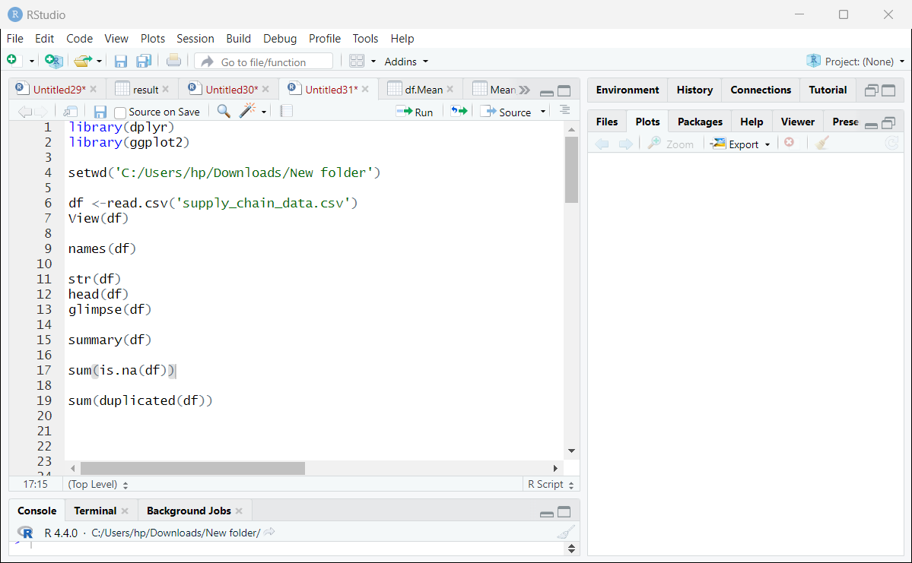
Data Exploration and Cleaning

Slide 6
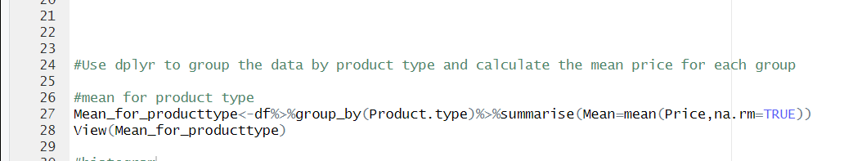
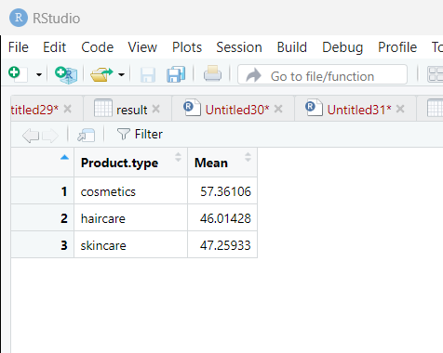

Slide 7
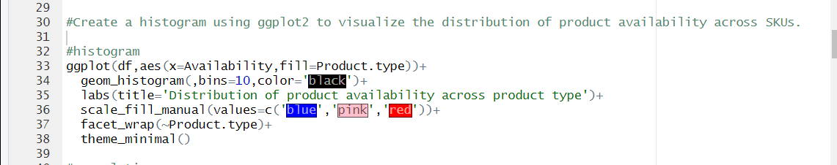
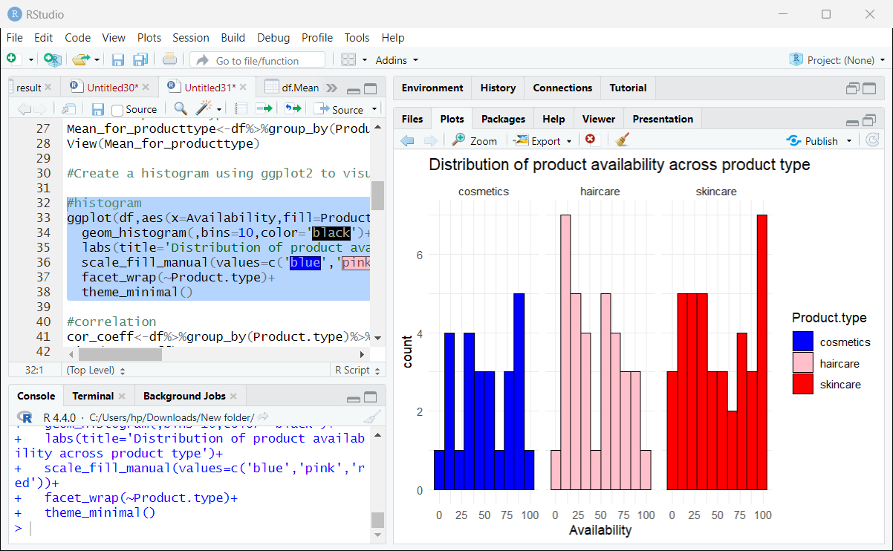

Slide 8
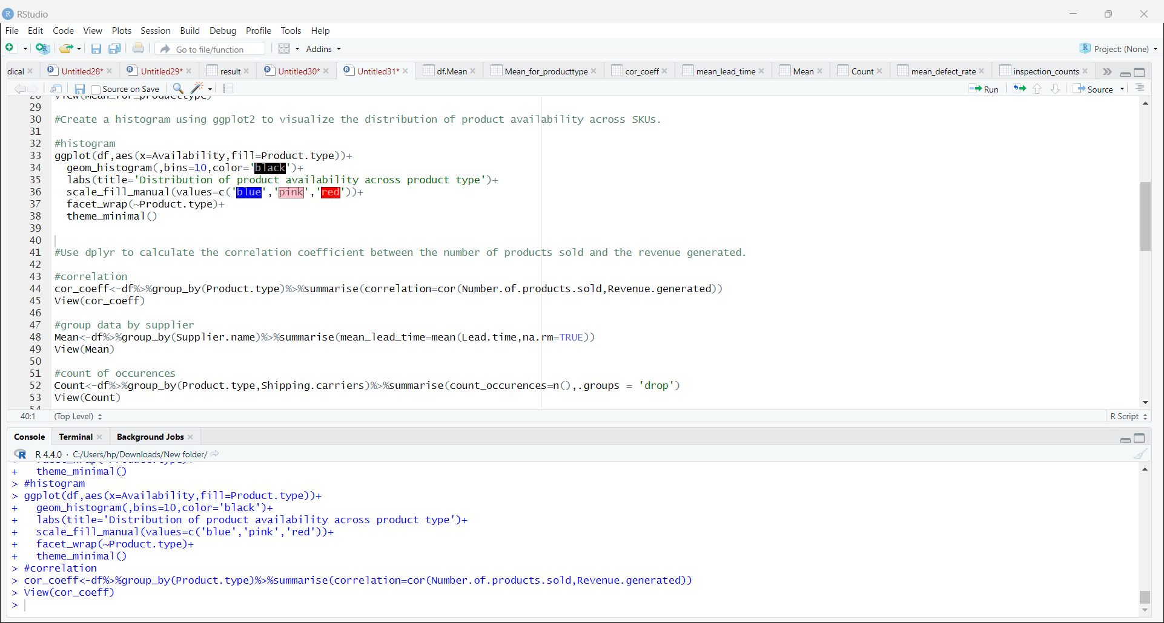
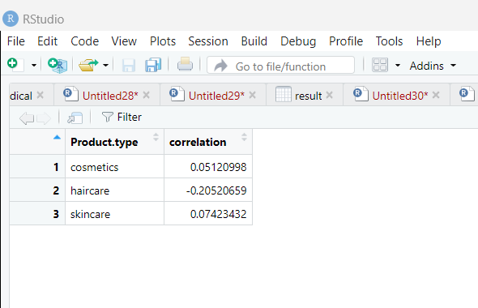

Slide 9
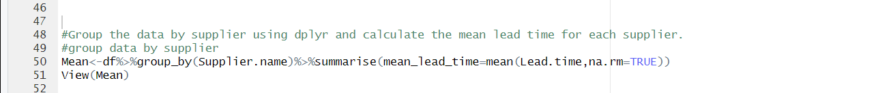
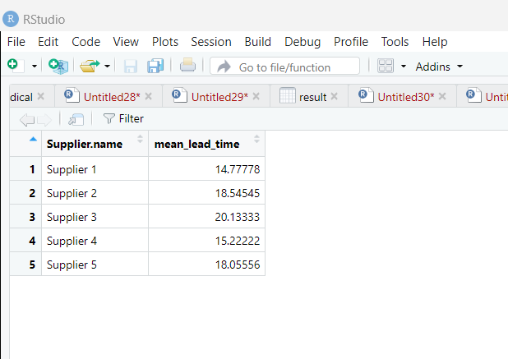

Slide 10
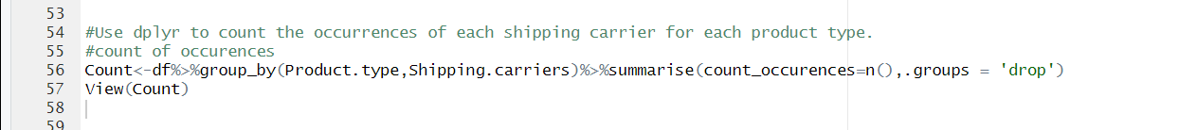
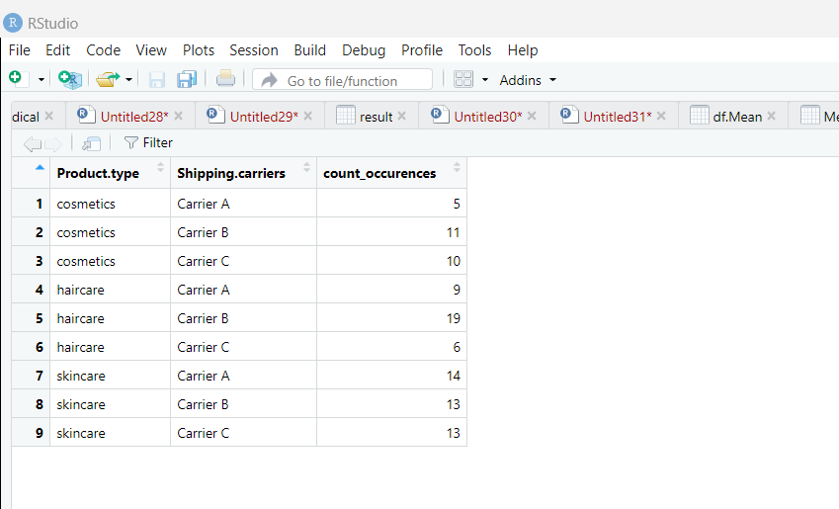

Slide 11
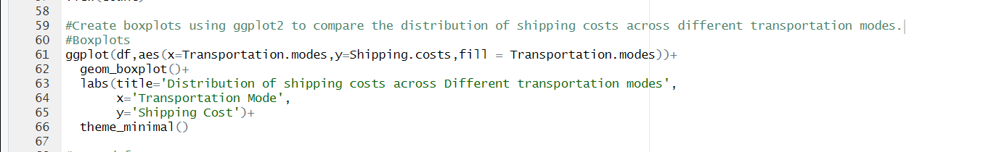
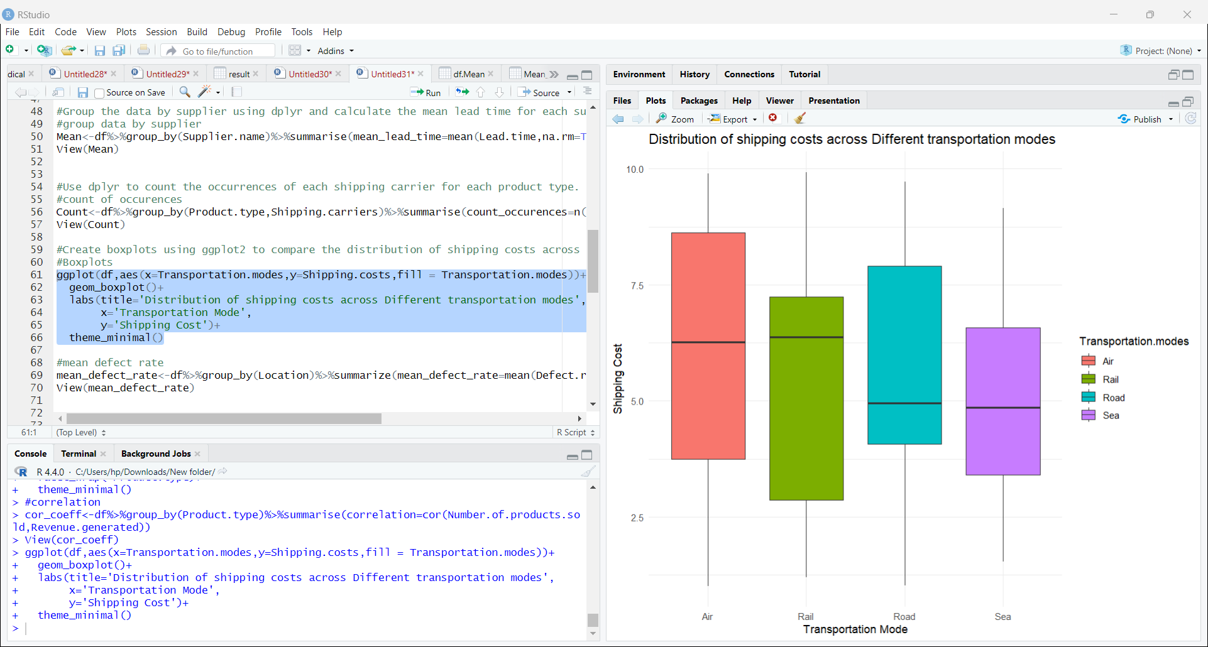

Slide 12
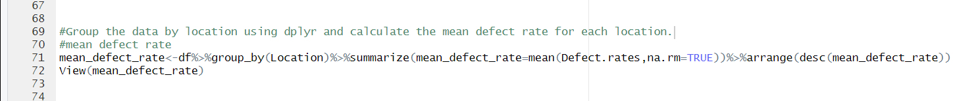
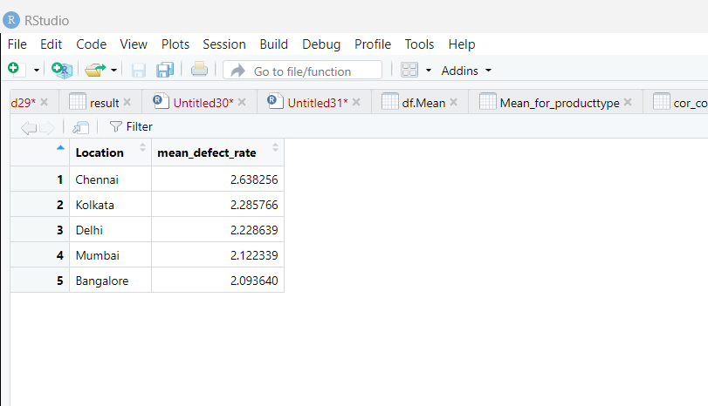

Slide 13
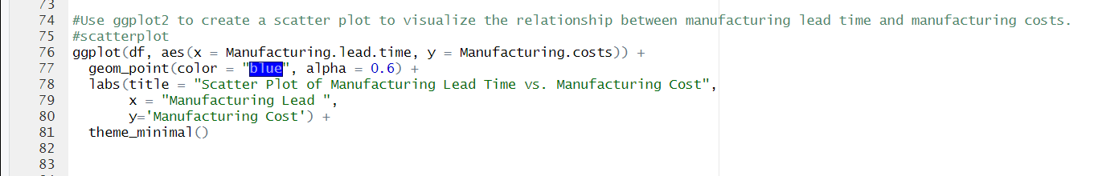
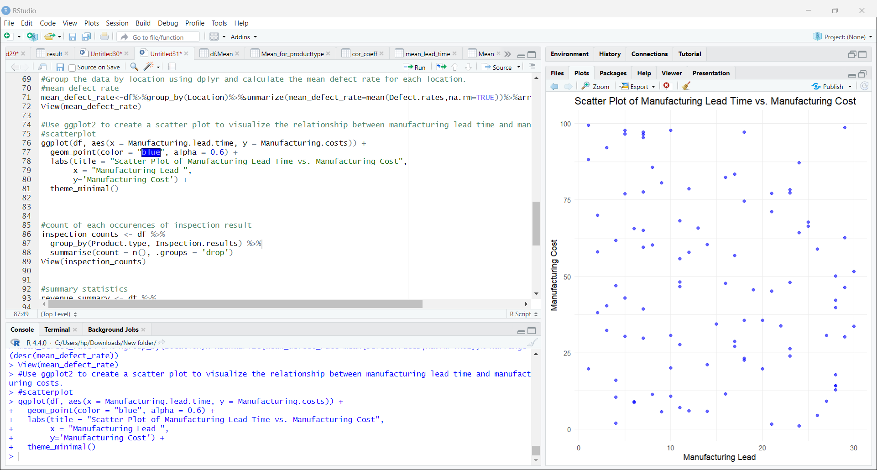

Slide 14
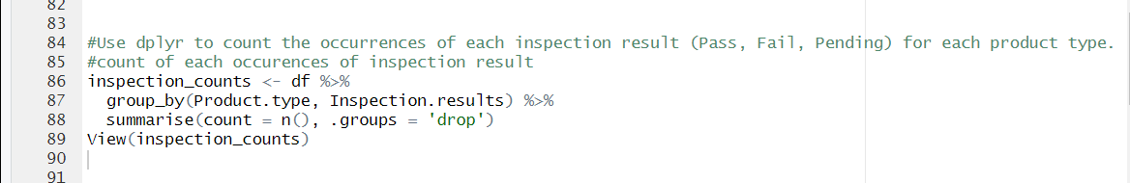
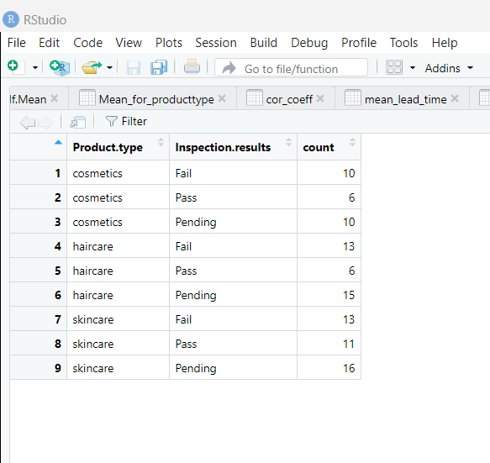

Slide 15
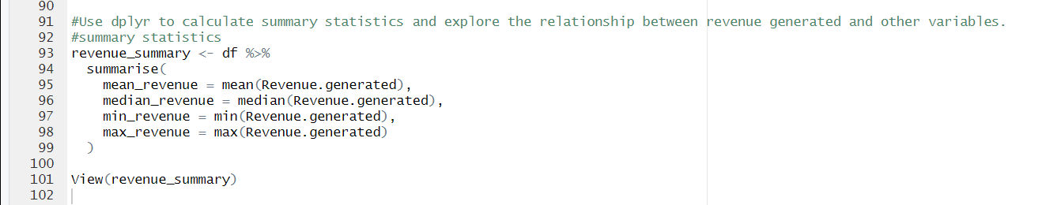
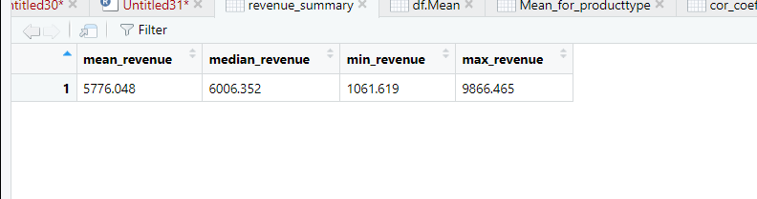

Slide 16
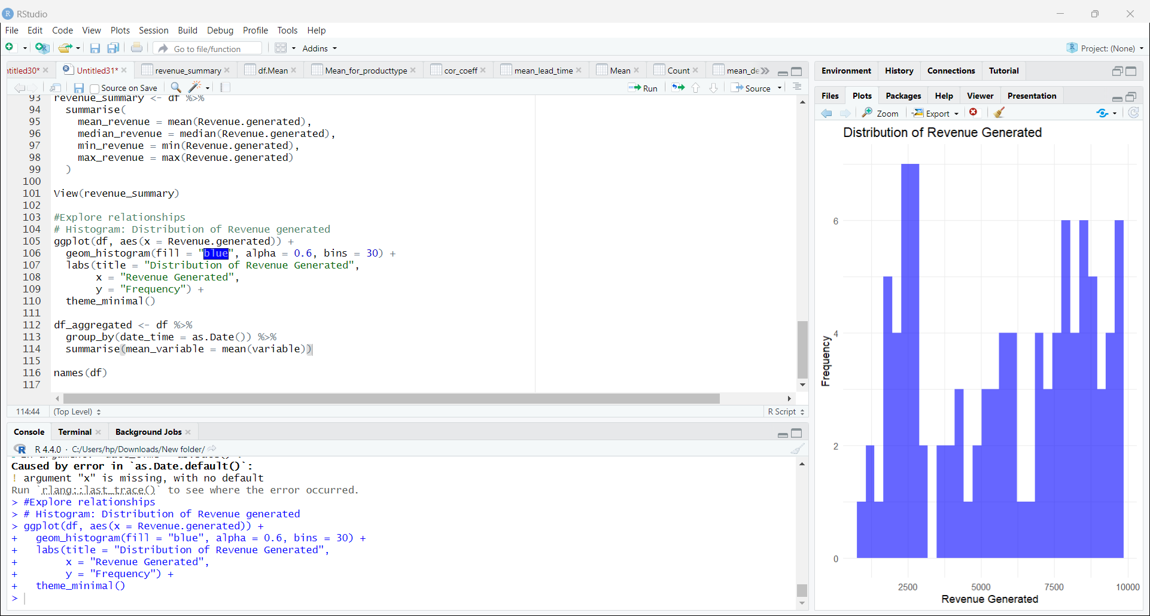

Slide 17
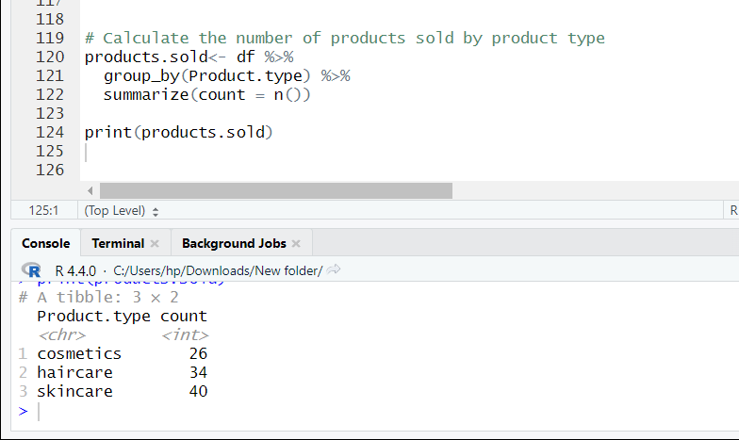

Slide 18
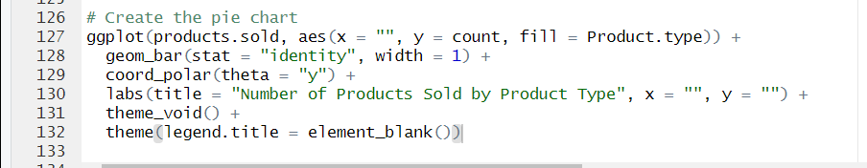
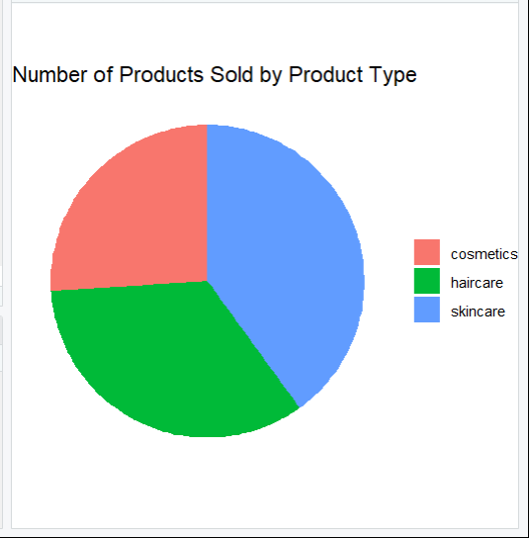

Slide 19
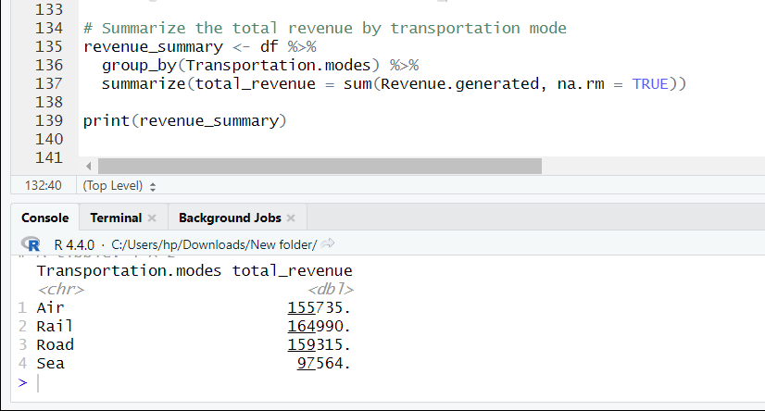

Slide 20
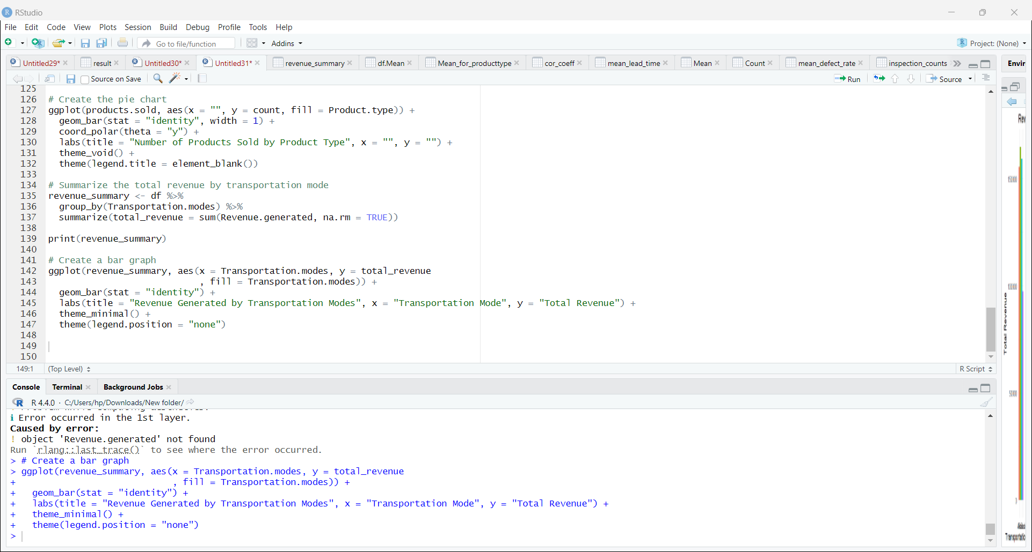
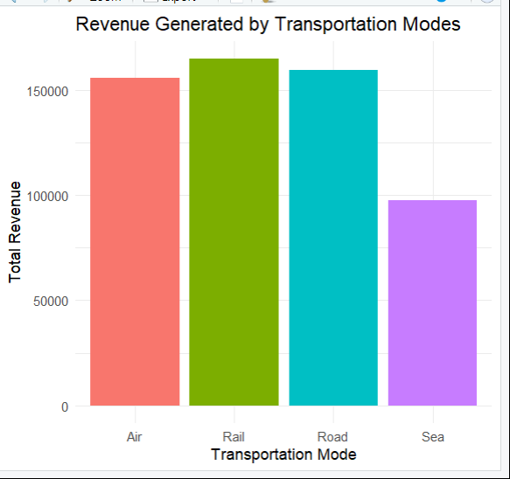

Slide 21
Thank you
By Kanaka ….

